Slide 1
HELP International Country Aid Analysis Clustering & PCA Assignment Report
Ajoy Nambiar

Slide 2
Assignment Objective and Methodology
Business Objective: HELP International is an international humanitarian NGO that is committed to fighting poverty and providing the people of backward countries with basic amenities and relief during the time of disasters and natural calamities. Using country socio-economic data we need to identify countries which are in the direst need of aid.
Methodology:
A nine feature socio-ecomic factor are provided for each of the 167 countries. These features are collinear
Clean the data and perform EDA. We will use derived metrics where suitable eg % Health converted to Heath per person
Data is standardized as features are different units and scale
Using Principal Component Analysis (PCA) we will attempt to reduce the dimension while retaining the information/ variance
From PC converted data we will attempt to cluster using unsupervised learning techniques like Kmeans and Hierarchical clustering cluster countries based on their socio-economic factors
We will treat the outliers i.e. countries with very high or very low development characteristics to enable clustering algorithm to work
Once under-developed country cluster is identified we will use is centroid/ mean/ characteristics to find the most under developing countries which require aid the most
A comparison of Kmeans and hierarchical clustering will be done and if variations seen will try to explain them.
Notes:
Business objective: The objective is to identify the best sectors, countries, and a suitable investment type for making investments. The overall strategy is to invest where others are investing, implying that the 'best' sectors and countries are the ones 'where most investors are investing'.

Slide 3
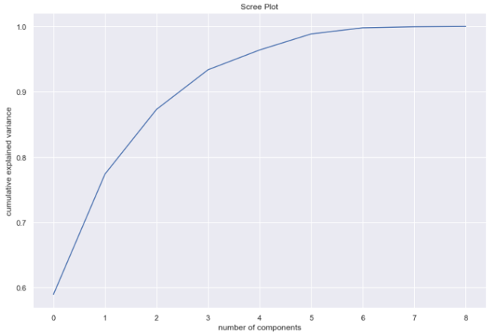
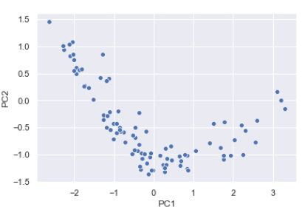
Principal Component Analysis and Clustering Results
PCA Analysis:
After converting 3 % features -Health, import and export to per person, data is scaled before performing PCA
Using Scree Plot it is shown a 5 PC (from original 9 features) can explain more than 95% variance
Post PCA outlier analysis drops 72 countries some of which may be of interest
Clustering:
Hopkins measure on PCA modified dataset is consistently above 0.5 which indicates data can be clustered
A silhouette score and elbow curve together show a 3 cluster Kmeans will be optimal.
Data is clustered and original 9 features are merged back to explain the meaning of clustering number. Here
0- under developed Countries
1 - Developing Country
2- developed countries
Under developed countries have low PC1 and high PC2
Hierarchical Clustering also shows 3 main clusters
Cluster analysis is also similar for both type of unsupervised machine learning.
Scree Plot
PC1 vs PC2 scatterplot

Slide 4
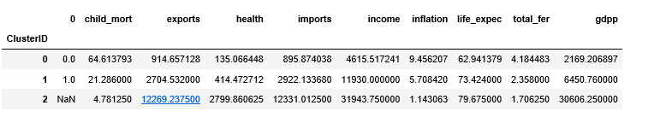
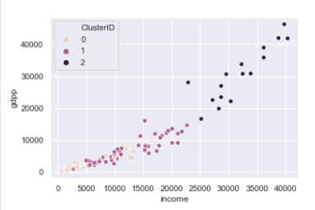
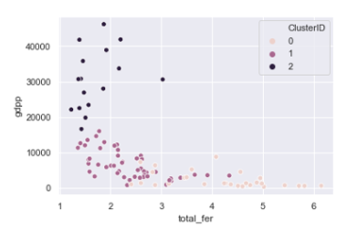
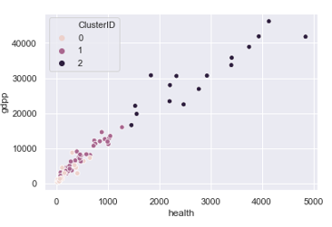
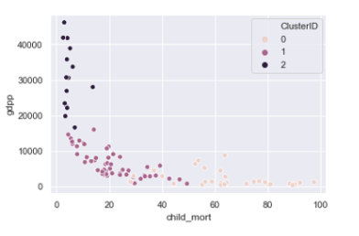
Visualization - KMeans Summary
Clustering Analysis
gdpp, child_mort, total_fer, inflation, income, health, imports and exports show large variation between clustering
Using these features we can look at countries poorer than 0 cluster and explore countries removed during outlier analysis before unsupervised machine learning clustering.
Feature variation on clustering

Slide 5
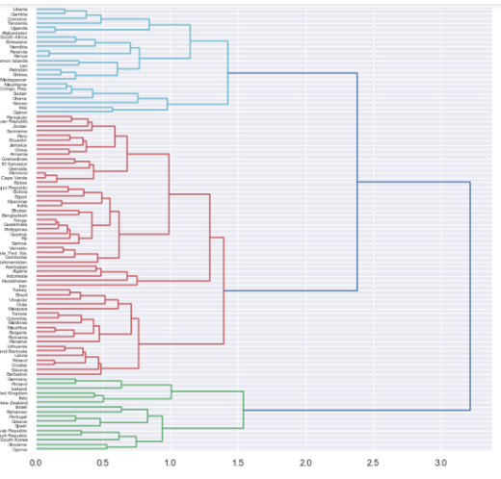
Visualization – Hierarchical Clustering
Clustering Analysis
Average, Single and complete dedogram give same result
3 Main country cluster are formed with 23 countries
The cluster mean analysis shows they are similar to K-Means 3 cluster which comprised of 29 countries
Dendogram

Slide 6
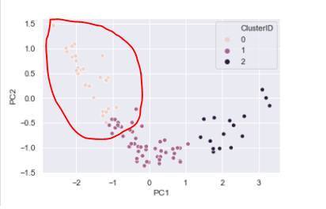
Final List of Countries
Based on socio-econimic factors the five countries which require aid the most
Congo, Dem. Rep.
Sierra Leone
Burundi
Malawi
Uganda
Methodolgy use to identify these countries was use under-developed country cluster centroid/ mean to list of countries lower than poorest centroid
Since the list was more than five countries I transformed this list back to five PCs and used PC1 and PC2 to find most under developed country
PC2>-0.5 and lowest PC1 countries are in the direst need of help
Low PC1 and high PC2 are poorest countries

